Slide 1
Neural Networks
Explore ML
Notes:
If you have read anything about machine learning you may have come across the term "Neural Network". They are a popular choice for machine learning models because of their ability to handle complex data and make accurate predictions where simpler models might fall short.

Slide 2
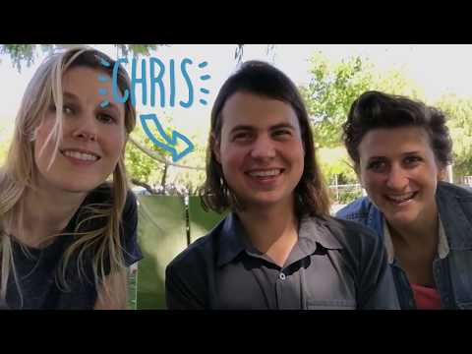
Notes:
Questions after the video:
What is your definition of a neural network?
What can a Neural Network do?
What questions do you have?
What was interesting or surprising?
Video Source: Google, How machines learn (9:00)

Slide 3

ACTIVATED NEURONS
INPUT LAYER
OUTPUT LAYER
Image adapted from becominghuman.ai by Venkatesh Tata
Notes:
What is a neural network?
In short it’s a mathematical function that maps a given input to a desired output.
In the Introductory module, you learned about a couple types of machine learning models such as classification, regression, etc. Simple models work fine work simple data but as soon as you want to interpret complex data like an image, audio, or even numerical data with lots of variables e.g. for housing prices = location + number of bedrooms + size + etc you need something capable of dealing with that complexity.
These simpler models are connected into layers and this is where the depth of "deep" learning comes from.
In reality a neural network is a big complex mathematical function which looks nothing like what you see here but the diagram may help you see what's going on.
Like any other machine learning system, a model is trained with data fed into the model and it attempts to make a prediction. At first the prediction will be essentially garbage but that feedback is used to improve the model.
Once the prediction quality is sufficient, the model is tested with new data and it makes a prediction based on what it learned from the training data.
What this diagram doesn't show is how each neuron is able to learn and improve based on feedback. Let's look more deeply at how a neuron is able to make a decision.
Image adapted from becominghuman.ai by Venkatesh Tata

Slide 4
Perception of Artificial Neuron
Activate Neuron
Input
Activation Function
Yes
No
Do not activate neuron
Notes:
Apply an activation function to a neuron. This is the mathematical way of setting the threshold or condition for activating a neuron
This is similar to if...then statements in programming e.g., If time > 11am eat lunch.
The neuron checks to see if the input value meets the activation function's requirements
If it does not, then do nothing and pass no value onto any connected neurons in the network
If it does, do something to the data and pass the result as an input to next neuron.
This operation is carried out across all of the nodes in the network allowing very complex patterns to be learned and predictions to be made
Let's look at a couple of examples

Slide 5
Perception of Artificial Neuron
Activate Neuron
5
< 10
Yes
Do not activate neuron
Notes:
The number 5 is the input to this neuron.
The neuron's activation function has learned to check if a number is < 10.
This input passes the test and so the neuron is activated.
This is one of the simplest forms of a neural network. It's effectively the same as linear regression or fitting a line to data.

Slide 6
Perception of Artificial Neuron
Activate Neuron
Has a curve?
No
Do not activate neuron
Notes:
The input to this neuron is an image of the number 7
The neuron's activation function has learned to check if an image like this has a curve
This input does not so it fails to pass the test and so the neuron is not activated.

Slide 7
Perception of Artificial Neuron
Activate Neuron
Has a curve?
Yes
Do not activate neuron
Notes:
However, the input to this neuron is an image of the number 6
This input does have a curve so it passes the test, the neuron is not activated, and the information is passed to the next neuron.
Simple functions like these can combine to make more complex decisions. For example, the ability of this neuron to determine whether or not the input has a curve is due to other neurons checking to see for example if a pixel is black or not.
[Pause and ask for questions or anything that needs clarification]

Slide 8
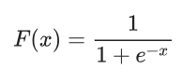
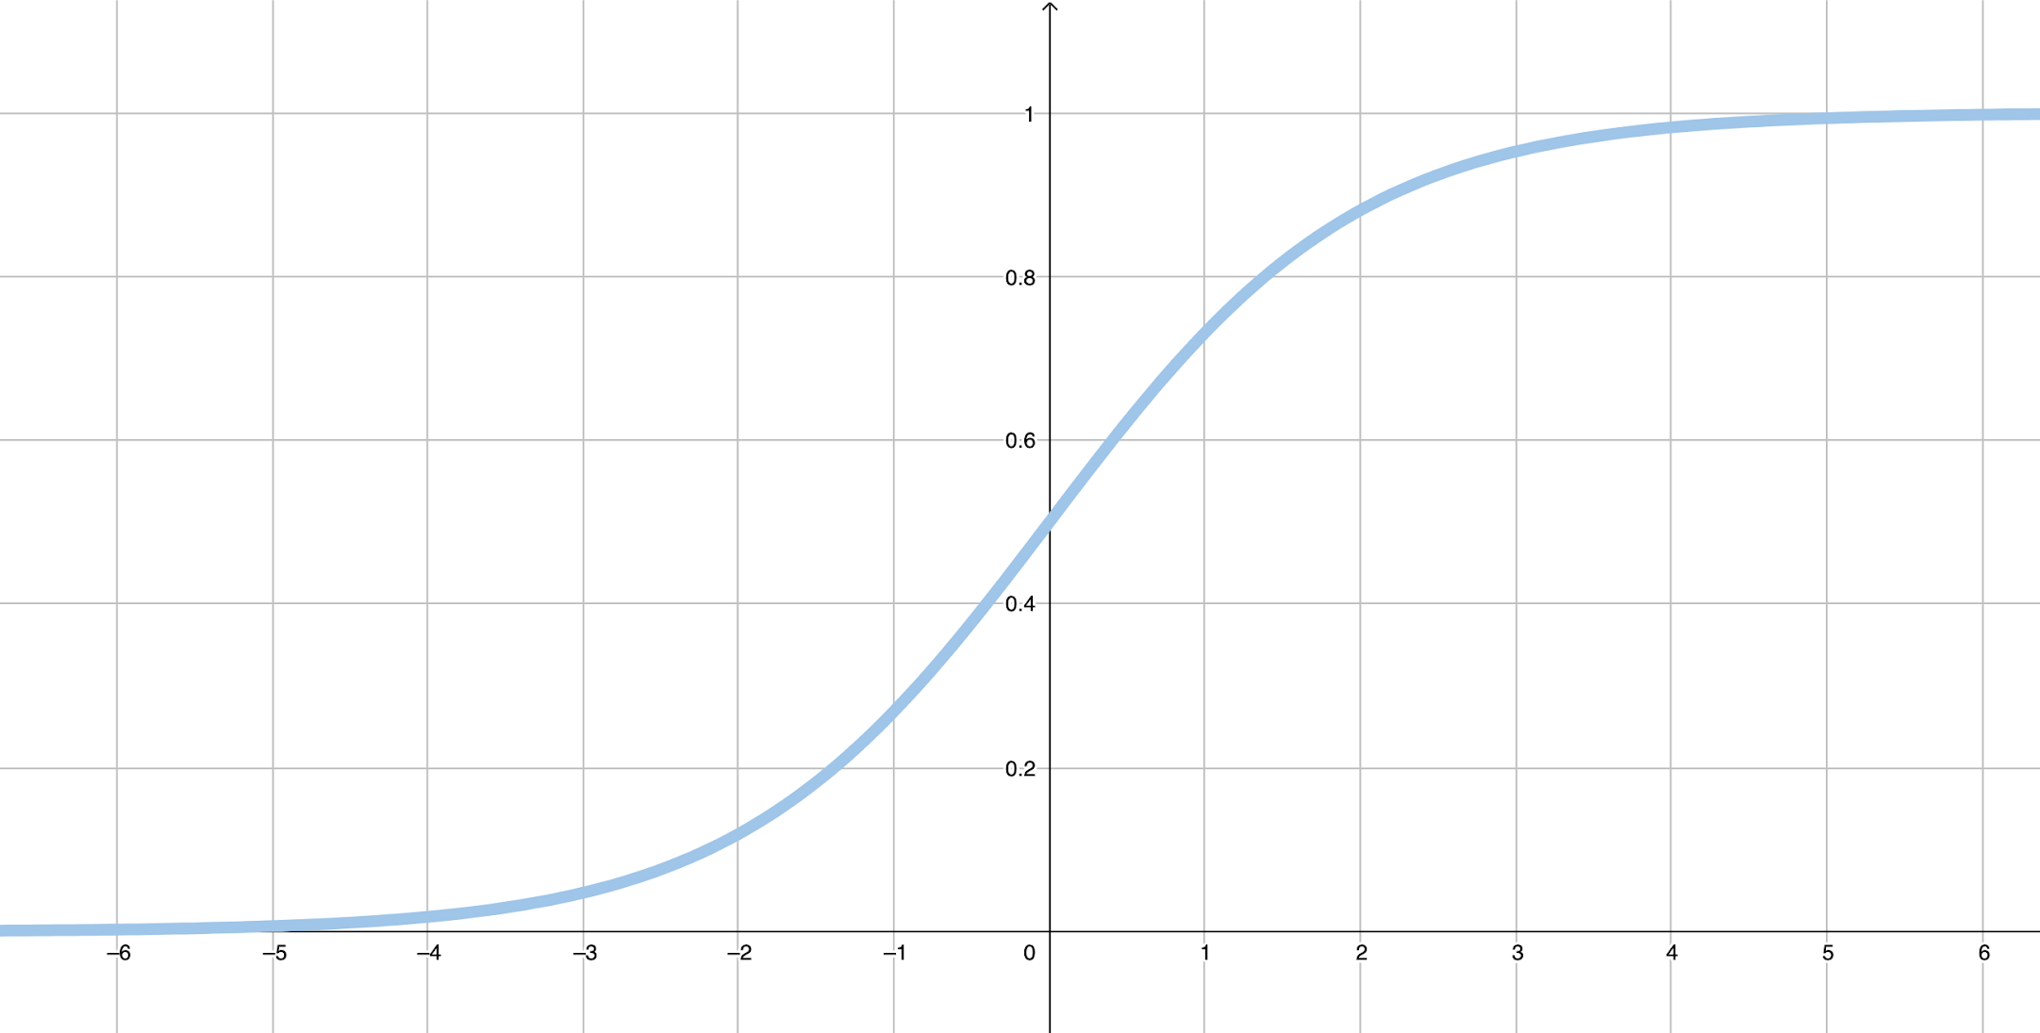
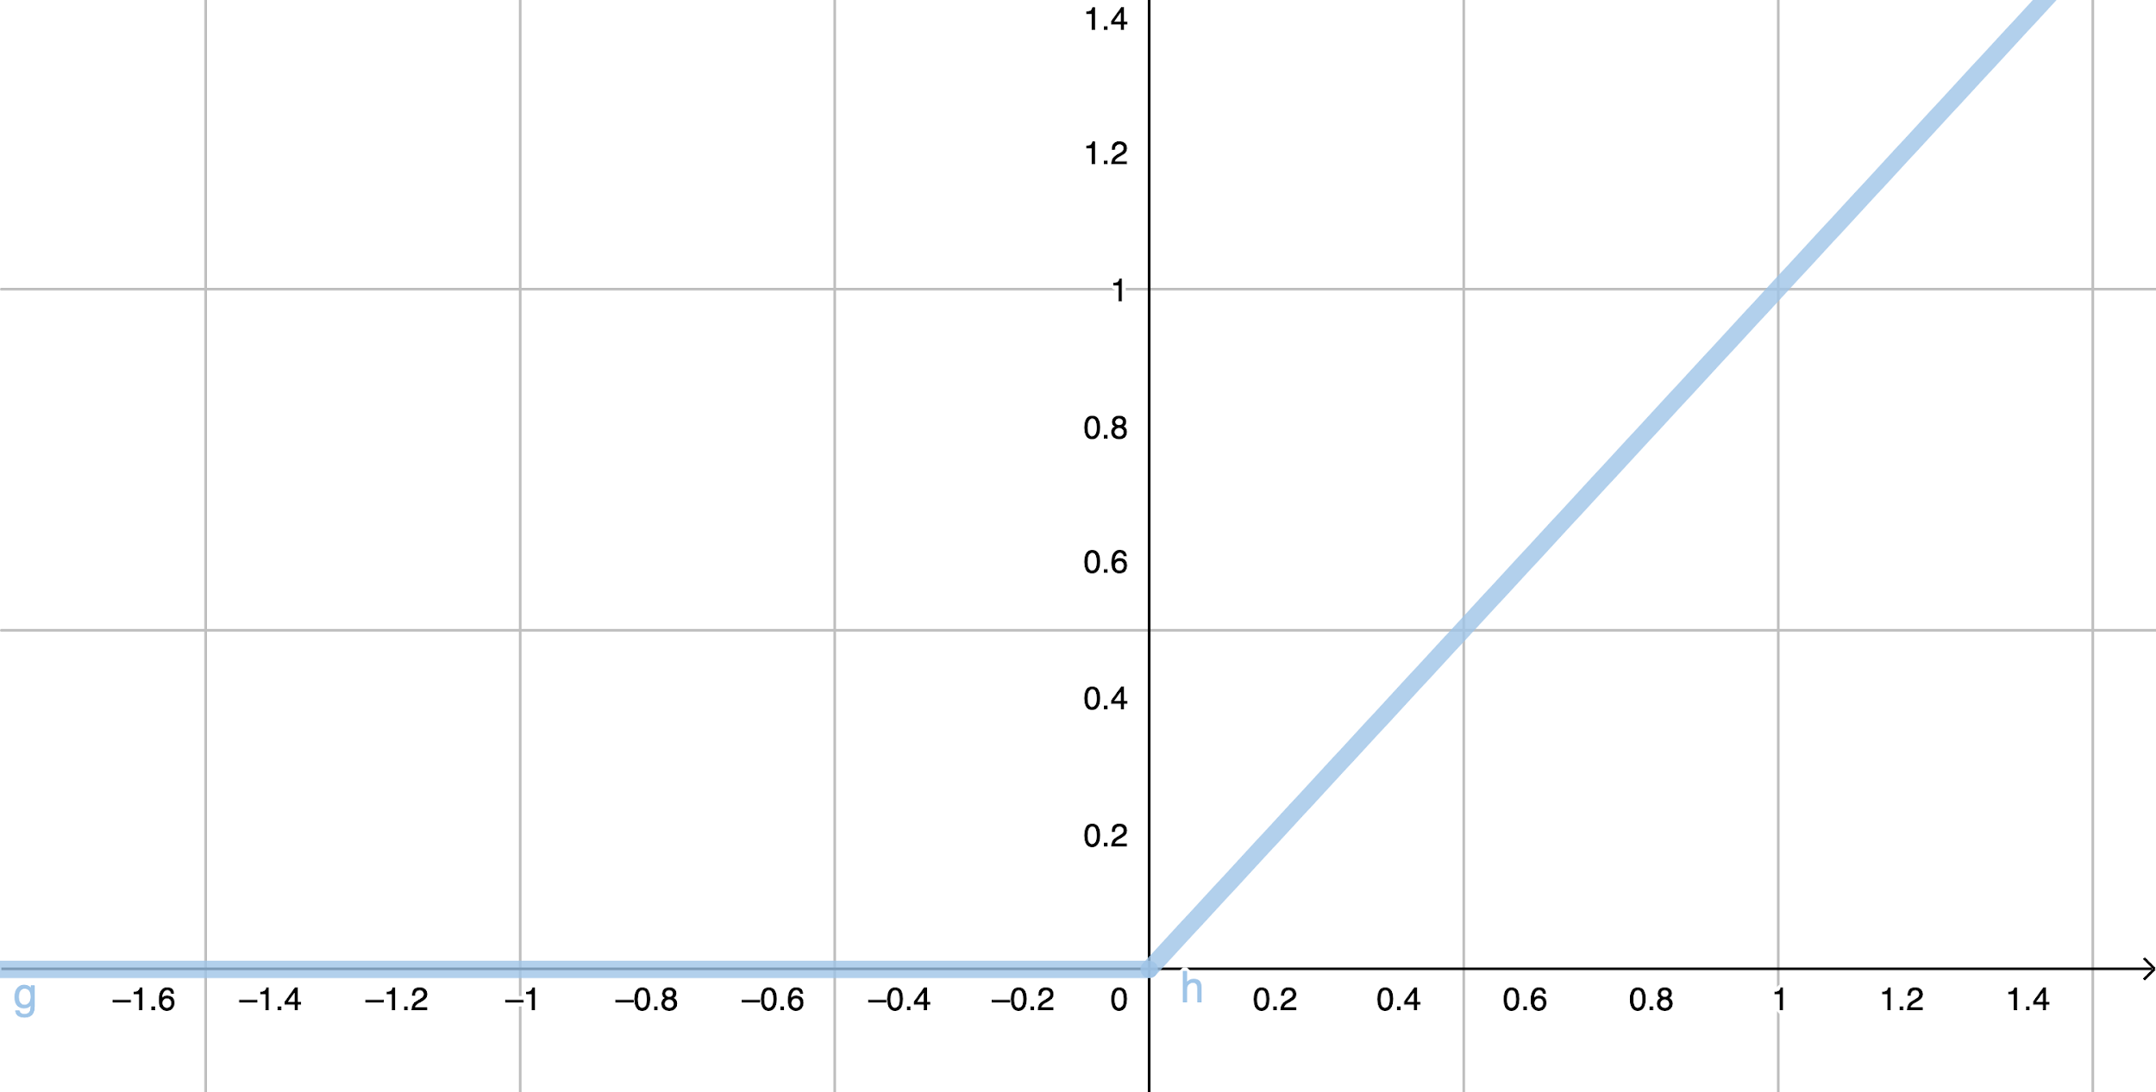
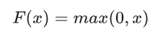
Common Activation Functions
Sigmoid activation function converts the weighted sum to a value between 0 and 1.
ReLU (Rectified Linear Unit) activation function often works a little better than a smooth function like the sigmoid, while also being significantly easier to compute.
Notes:
Researchers describe the field of machine learning less like engineering and more like scientific exploration. For example, for a long time the sigmoid activation function was used until the ReLU function was discovered to be more efficient and effective for many situations.
It's not necessary to know all of the mathematics behind machine learning in order to use it but it's shown here to reinforce the concept that machine learning is at its core a complex mathematical function that is trained to do well on a particular goal.

Slide 9
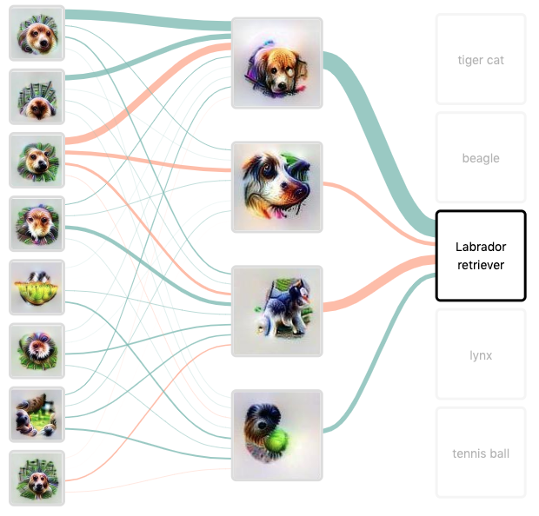

Image adapted from Distill.pub article by Chris Olah et al.
Notes:
A neural network can be comprised of many hidden layers. These are intermediate steps to get from the prediction to the output. For example a neural network may have layers to detect certain colors, and shapes and other layers to differentiate between certain types of animals and breeds.
It's important to clarify, the neural network does not know what a dog or cat is, it's just learning to do what we want it to do based on feedback and the patterns it detects.
But how does a neural network learn from feedback? Neural networks were loosely modeled after the biological brain. The connections between neurons can be strengthened and weakened using weights and biases. For example, when a dog receives a treat and a pat on the head for retrieving a ball, it is more likely to do that again.
Weights and biases allow a neural network to learn what pathways "work" for a certain task and bias the network to use those pathways again. This makes the network more effective and efficient at making predictions.
All of these complex calculations are accomplished far more quickly and often than a human could ever hope to do. It requires a lot of computing power to achieve high quality results which is why Neural Networks were once thought infeasible but now data centers (also known as computing clouds) with greater computer processing power make neural networks a reality.
Image adapted from Distill Pub - Building Blocks of Interpretability

Slide 10
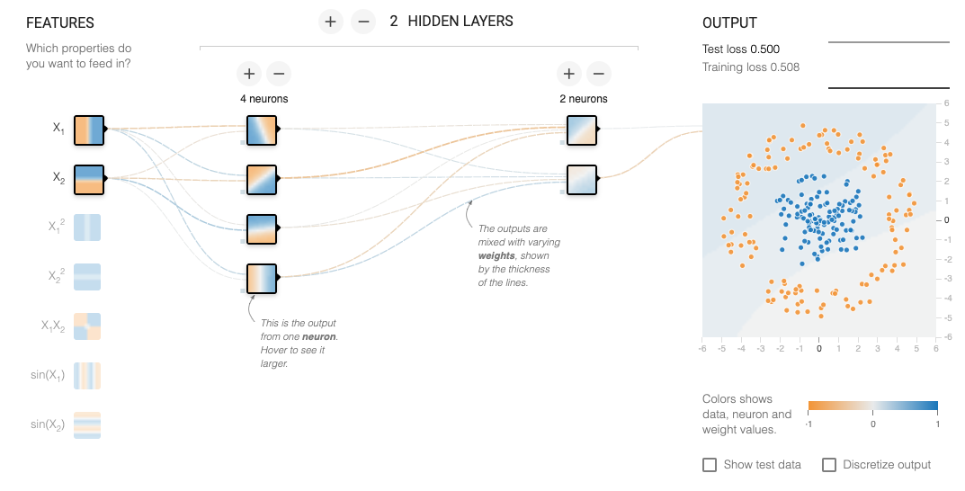
Notes:
Introduction to TF Playground
Machine learning is typically implemented using programming languages like Python and R though speciality libraries like scikit, Theano, and TensorFlow exist to make it even easier.
For those who do not yet write code, there are APIs offered to make machine learning an option.
In this session, we are going to use TensorFlow Playground a tool for exploring and learning about machine learning without the need to write code.

Slide 11
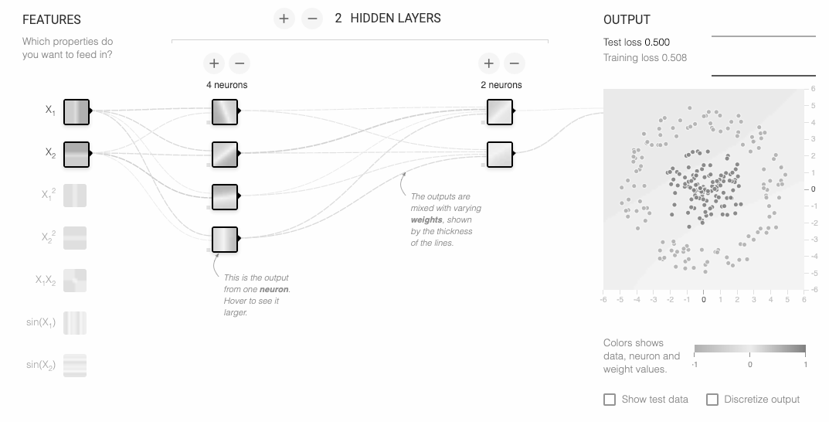
Notes:
While your goal with machine learning may be more interesting like which of these x-rays contain evidence of cancer, we'll start simple. Your goal is to separate the blue and the orange dots.
Question:
Could you do this with only a line?
No
What would you need in order to successfully separate the lines?
A circle which can be made by combining a bunch of lines and functions (it may be helpful to draw this on the whiteboard if you have one available)
Neural networks can be built to solve complex nonlinear problems.
While you can see the output on the 2-D graph, the effectiveness of the model is measured with loss. Loss is the difference between your model's prediction and the data. In general, the lower the loss, the better your model.

Slide 12
Notes:
On your left you'll see your features. Features are the information drawn from your data examples which distinguish one example from another.
In TF Playground these are simply mathematical functions like a vertical, horizontal line, and their combinations.
Real world examples might include
Dog vs Cat
Size
Color
Length of tail
Classifying Numbers
Number of curves
Number of lines
Video Recommendation
Video Topic
Number of Views
Creator of Video
Video user watched
Predicting the Price of a House
Location
Number of bedrooms
Size of property
Predicting which Ad to Display
User's query
Type of device
Time of day

Slide 13
Notes:
Hidden Layers
This is where the complex patterns in the data are discovered.
Permutations of the featured data is tested on how well it separates the data.
The outcome is graded, this is known as loss. This is used as feedback to improve the model.
There are some rules of thumb for crafting neural networks but it's not likely I could tell you before what the right answer is, a high-quality neural network takes experimentation and iteration.
Open TF Playground and demonstrate playing around with the tool.

Slide 14
https://developers.google.com/machine-learning/crash-course/introduction-to-neural-networks/ playground-exercises
Notes:
Have learners go to this URL.

Slide 15
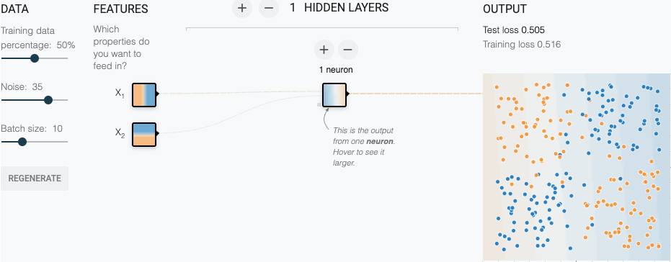
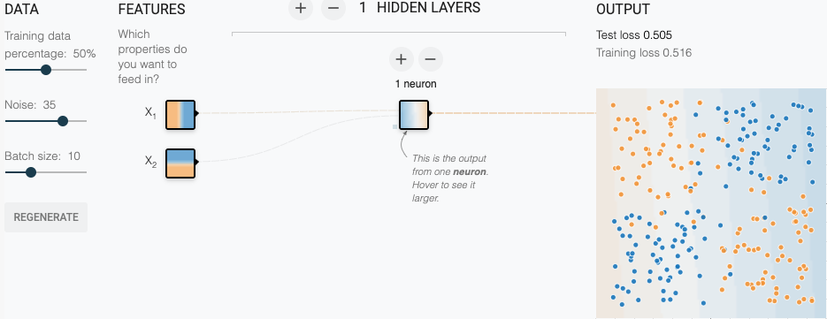
Playground Exercises
First Neural Network
Complete Tasks 1-3
Be ready to share your findings with the class.
Notes:
Complete the tasks in the first exercise.
[Give learners 10 minutes to explore the exercise.]
Task 1 question: Will this model learn any nonlinearities?
The Activation is set to Linear, so this model cannot learn any nonlinearities. The loss is very high.
Task 2 question: Can you create a model that can learn nonlinearities?
The nonlinear Activation function can learn nonlinear models. However, a single hidden layer with 2 neurons will take a while to learn the model. These exercises are nondeterministic (meaning the data is randomized), so some runs will not learn an effective model, while other runs will do a pretty good job.
Task 3 question: What is the smallest number of nodes and layers you can use that gives test loss of 0.177 or lower?
Playground's nondeterministic nature shines through on this exercise. Some runs produce very low test loss with 3 Hidden Layers, arranged as follows:
First layer had 3 neurons.
Second layer had 3 neurons.
Third layer had 2 neurons.
However, other runs with the same configuration yielded very high loss.
Potential key discussion points:
What worked well in this exercise?
Do you have a strategy you would like to try in the next exercise?

Slide 16
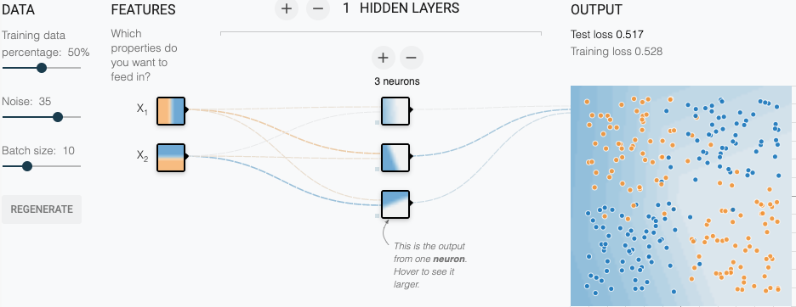
Playground Exercises
Neural Net Initialization
Complete Tasks 1-2
Be ready to share your findings with the class.
Notes:
Scroll down the same page and complete the next exercise.
[Give learners 10 minutes to explore the exercise.]
Task 1 question: What do the results say about the role of initialization in non-convex optimization?
The learned model had different shapes on each run. The converged test loss varied almost 2X from lowest to highest.
Task 2 question: Does adding a layer and a couple of extra nodes add any additional stability to the results?
Adding the layer and extra nodes produced more repeatable results. On each run, the resulting model looked roughly the same. Furthermore, the converged test loss showed less variance between runs.
Potential key discussion points:
What worked well in this exercise?
What is one tradeoff between traditional rule based programming and machine learning
With traditional methods you are most likely going to get the results you expect because there is a simpler, logical, and typically deterministic outcome. Consistent and expected results cannot be guaranteed with ML.

Slide 17
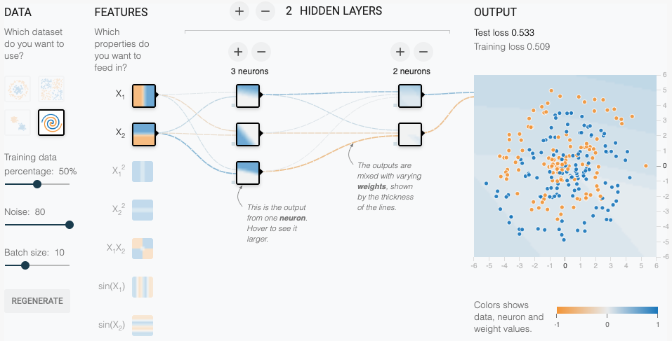
Playground Exercises
Neural Net Spiral
Complete Tasks 1-2
Be ready to share your findings with the class.
Notes:
Scroll down the same page
[Give learners 10 minutes to explore the exercise.]
Task 1 question: What is the best test loss you can get? How smooth is the model output surface?
Task 2 question: Do you get a better model with additional cross product features or other transformations like sin(X1) and sin(X2).? Is the model output surface any smoother?
Potential key discussion points:
What worked well in this exercise?

Slide 18
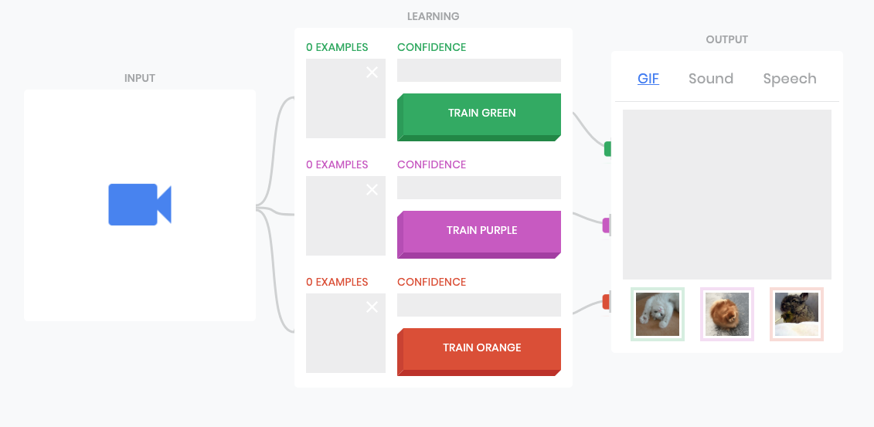
Limits of Neural Networks
Teachable Machine
g.co/teachablemachine
g.co/
teachable
machine
Play with it for few minutes
Can you confuse the machine?
Notes:
In this experiment we are going to use Teachable Machine, another online tool for machine learning. Teachable Machine is powered by Mobilenet, a neural network optimized for size so it can run on your mobile phone.
[Demonstrate how it works on the projector then let learners play with it for about 10 minutes]
[Have learners look up from their machines so you can describe the 2nd task]
With your knowledge of how machine learning works and its limitations. Can y ou come up with a way to confuse the machine?
[Give learners about 10 more minutes to explore, if they are struggling to find an example suggest:
Train it then change something when testing
hat/glasses
background
train it with 1, 3 fingers and then test with your fist, two hands
]
Discussion points:
What did you try that worked or didn't work?
Can you think of an application where this could be problematic?
How would you try to address that issue?

Slide 19
Questions / Review
What is a Neural Network?
When is it useful?
What can it do that a simpler model might not be able to do?
What is a limitation of a neural network (or ML in general)?
Notes:
If time allows, ask students to summarize each of these topics or ask questions.

